Slide 1
E-retail factors for customer activation and retention: A case study from Indian e-commerce customers
Customer satisfaction has emerged as one of the most important factors that guarantee the success of online store; it has been posited as a key stimulant of purchase, repurchase intentions and customer loyalty. A comprehensive review of the literature, theories and models have been carried out to propose the models for customer activation and customer retention. Five major factors that contributed to the success of an e-commerce store have been identified as: service quality, system quality, information quality, trust and net benefit. The research furthermore investigated the factors that influence the online customers repeat purchase intention. The combination of both utilitarian value and hedonistic values are needed to affect the repeat purchase intention (loyalty) positively. The data is collected from the Indian online shoppers. Results indicate the e-retail success factors, which are very much critical for customer satisfaction.

Slide 2
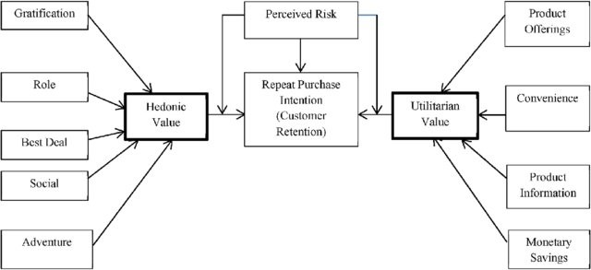

Slide 3
Problem Statement:
Customer retention
The customer retention is the process of engaging existing customers to continue buying products or services from the business.
Customer satisfaction
Customer satisfaction is a measurement that determines how happy customers are with a company’s products, services, and capabilities. Customer satisfaction information, including surveys and ratings, can help a company determine how to best improve or changes its products and services.
E-retail success.
How many happy customers does the particular e-retail website have.
Data Analysis.
Need to perform analysis on the data that has been provided and according to EDA, Visualization and other analysis, need to conclude the findings from analysis.

Slide 4
Understanding:
There are 2 excel sheets in the dataset that has been shared.
First, excel sheet is the detailed data of the e-retail website.
Second, excel sheet is the encoded data of the e-retail websites.
There are information of customers who do shopping online from different websites.
The information can be good as well as bad feedback for e-retail websites.
There are so many questions, polls and feedback columns in our dataset.
There are feedbacks & customer reviews of e-retail website such as:
Amazon.in
Flipkart.com
Myntra.com
Paytm.com and more.

Slide 5
Data Inspection
**df**
RangeI ndex: 269 entries, 0 to 268
Data columns (total 71 columns): 1 (int64) , 70 (object)
There are 166 duplicated records
Shape after removing duplicates: (103,71)
Dropping pin code column : (103,70)

Slide 6
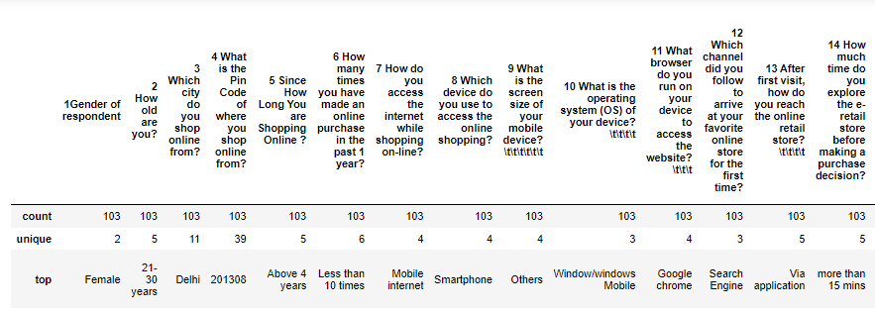
Descriptive Statistic:
First Dataset:

Slide 7
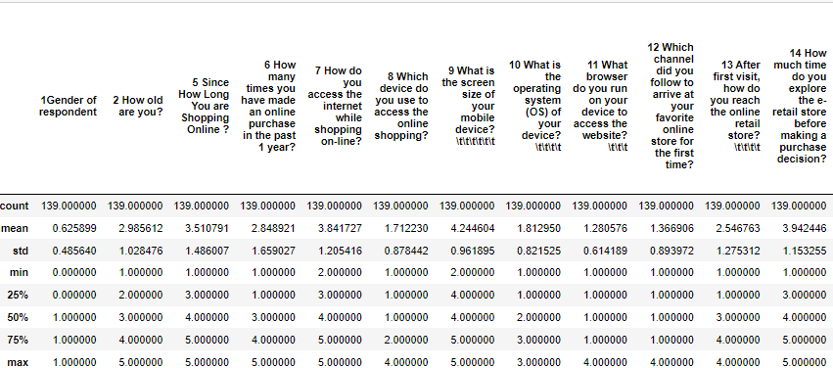
Second dataset:

Slide 8
EDA
Exploratory Data Analysis

Slide 9
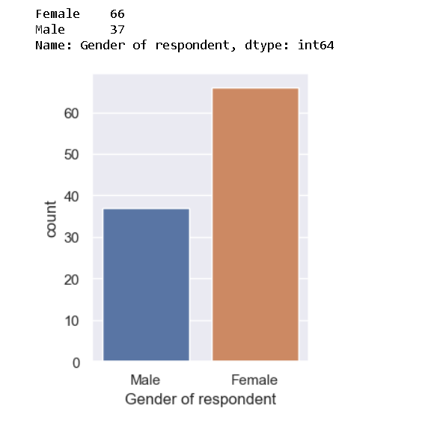
Number of females is more than the number of males as respondents
Which tells us that women are more shopping oriented than men.

Slide 10
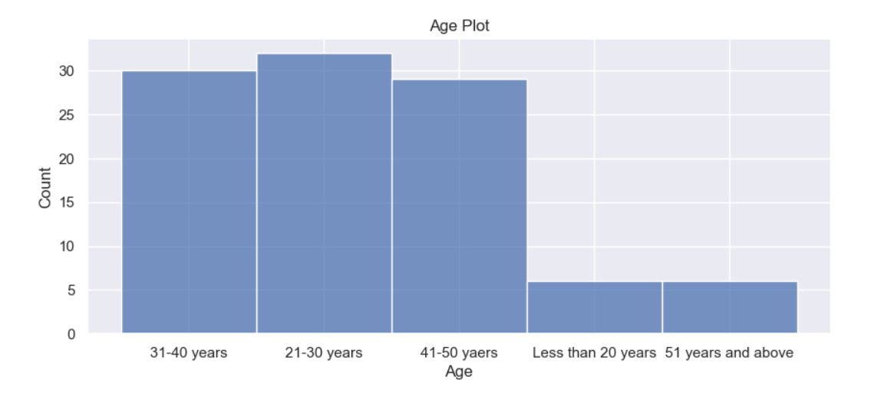
Most of the people in survey are from age group 21 to 50 years. While maximum population is of age group 31 to 40 years.
People of age group 51 and above have the least participation.
It is to be noted that numbers for respondent with age<20 years is quite low.

Slide 11
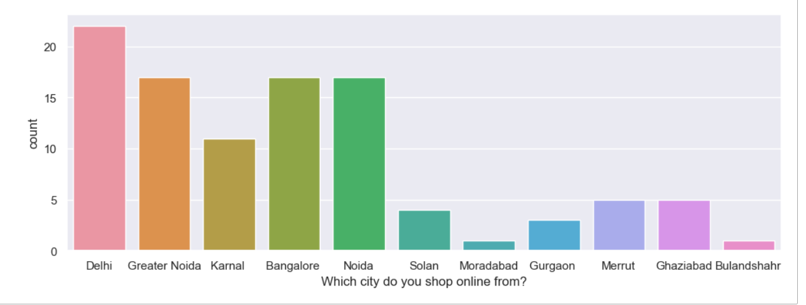
City of Shopper
Most shoppers are from Delhi while the least are from Bulandshahar and Moradabad. This shows that small towns have very less exposure and thus very less online customers.

Slide 12
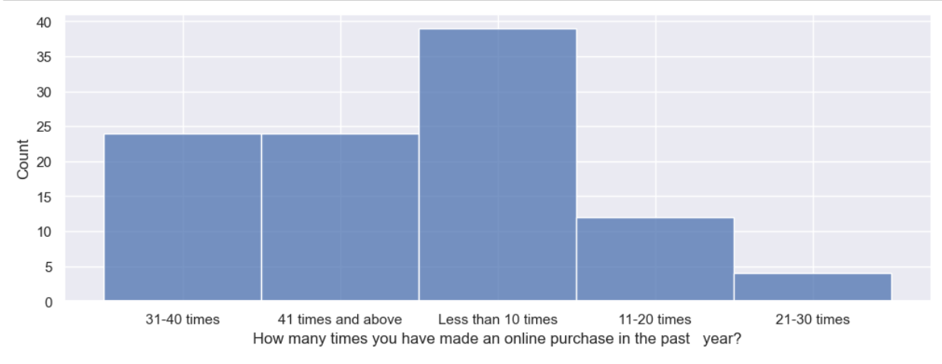
Purchasing times/year
Most people are purchasing less than 10 times in a year

Slide 13
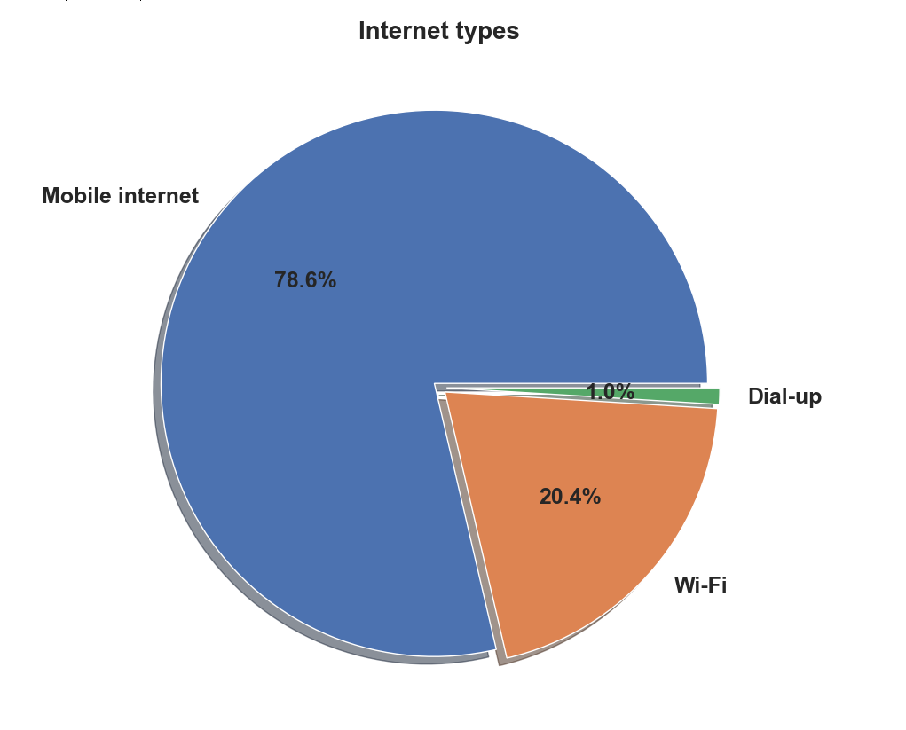
Most shoppers are using Mobile internet for shopping (78.6%)

Slide 14
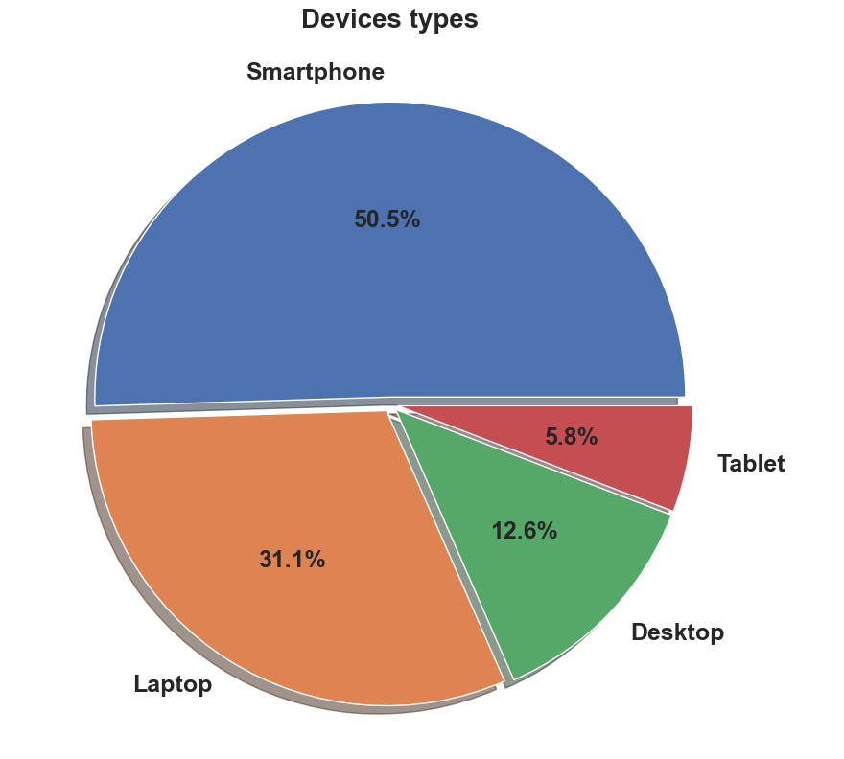
Most people are using Smartphones while shopping online.

Slide 15
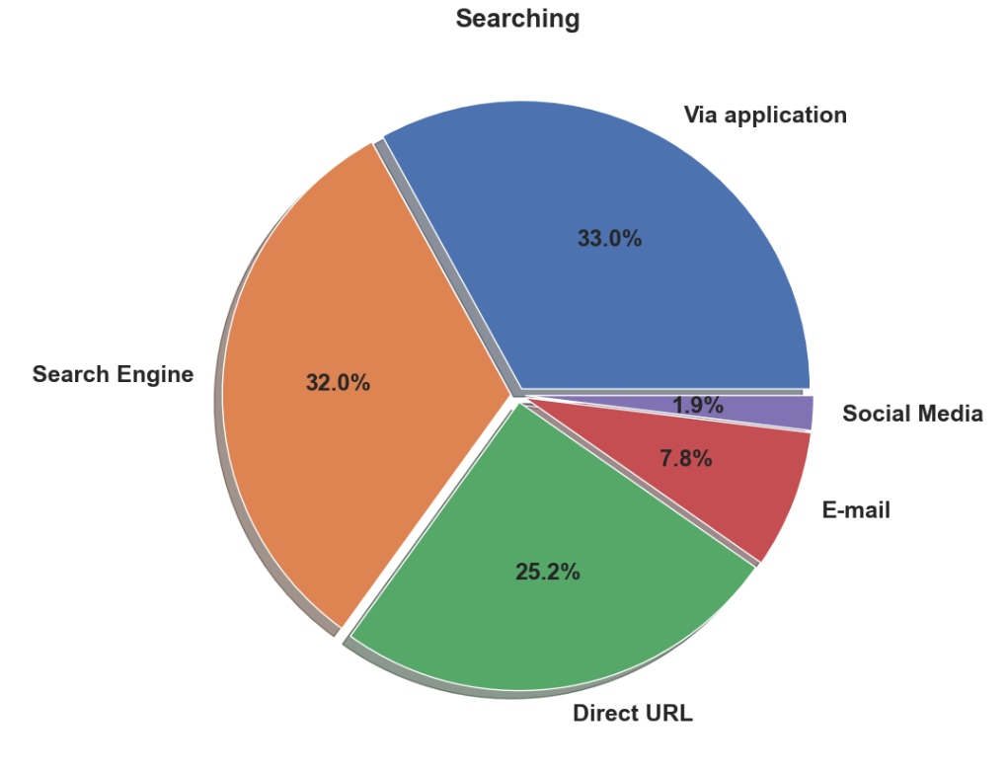
Most Dominant searching techniques are via Application or Search Engine.

Slide 16
POLL RESULTS

Slide 17
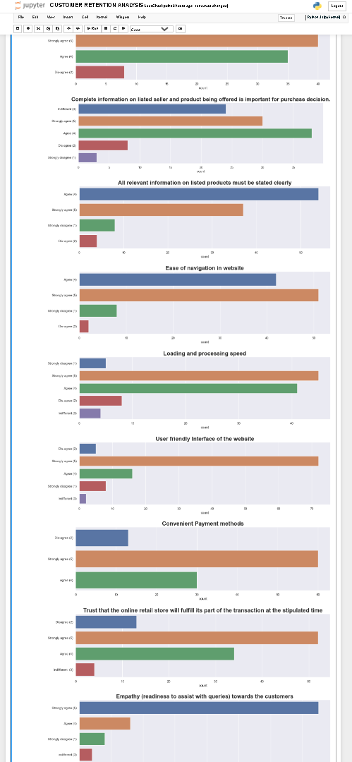
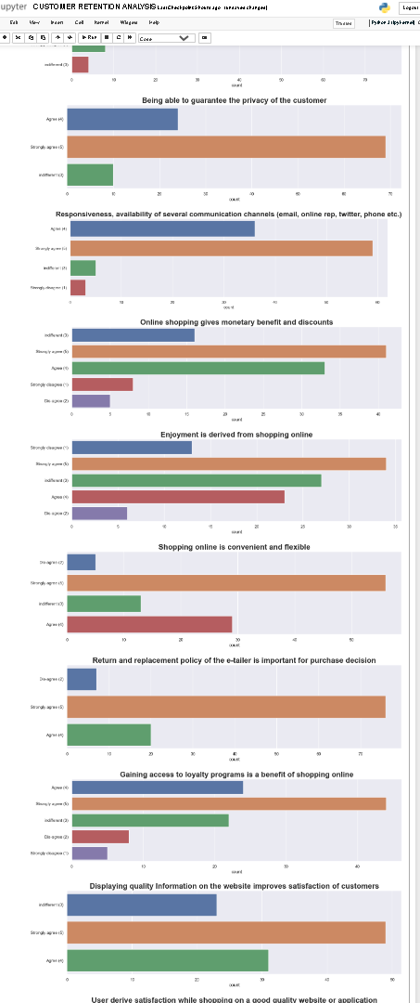
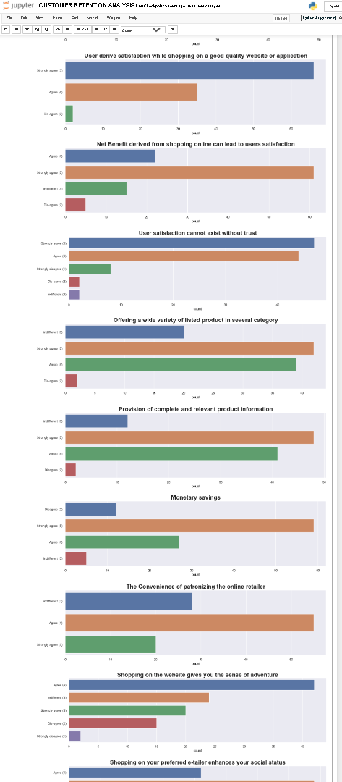

Slide 18
1. Most people agree that comparison of similar products is a important feature.
2. Clearly stated and Complete information of product and seller is important for people.
3. It is a fact that ease of navigation and speedy processing is one of the necessary features for any platform as no one wants to waste their valuable time waiting or researching.
4. User friendly interface and convenient payment method is very important for people.
5. Most of the customers agree that trust and Customer service is very important.
6. 75% people agree that online shopping gives them monetary benefits and discounts and is very convenient while more than 50% people shop online for enjoyment and adventure.
7. 80% customers derive satisfaction shopping on a good quality website which gives them monitory benefits.
8. 90% customers prefer a product with good return and replacement policy.
9. Most people are indifferent with the feeling of gratification or sense of preference for their favorite e tailor.
10. Value for money is a very important parameter for most of the customers.

Slide 19
Postive Feedback:
'From the following, tick any (or all) of the online retailers you have shopped from; ', 'Easy to use website or application', 'Visual appealing web-page layout', 'Wild variety of product on offer', 'Complete, relevant description information of products', 'Fast loading website speed of website and application', 'Reliability of the website or application', 'Quickness to complete purchase', 'Availability of several payment options', 'Speedy order delivery ', 'Privacy of customers’ information', 'Security of customer financial information', 'Perceived Trustworthiness', 'Presence of online assistance through multi-channel'

Slide 20
Negative Feedback:
'Longer time to get logged in (promotion, sales period)', 'Longer time in displaying graphics and photos (promotion, sales period)', 'Late declaration of price (promotion, sales period)', 'Longer page loading time (promotion, sales period)', 'Limited mode of payment on most products (promotion, sales period)', 'Longer delivery period', 'Change in website/Application design', 'Frequent disruption when moving from one page to another'

Slide 21
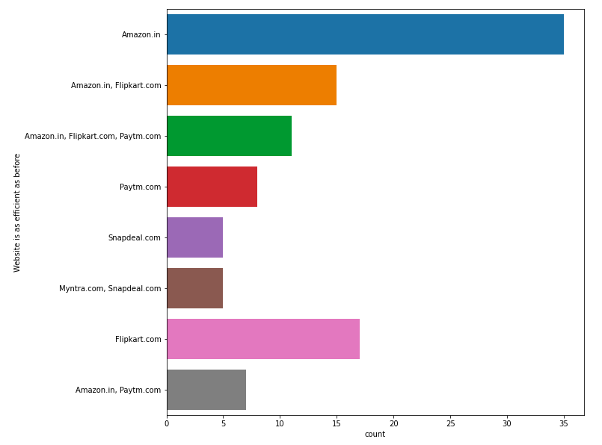
Website is as efficient as before
Positive for Website,
Amazon is still on the top and after that flipkart is there.

Slide 22
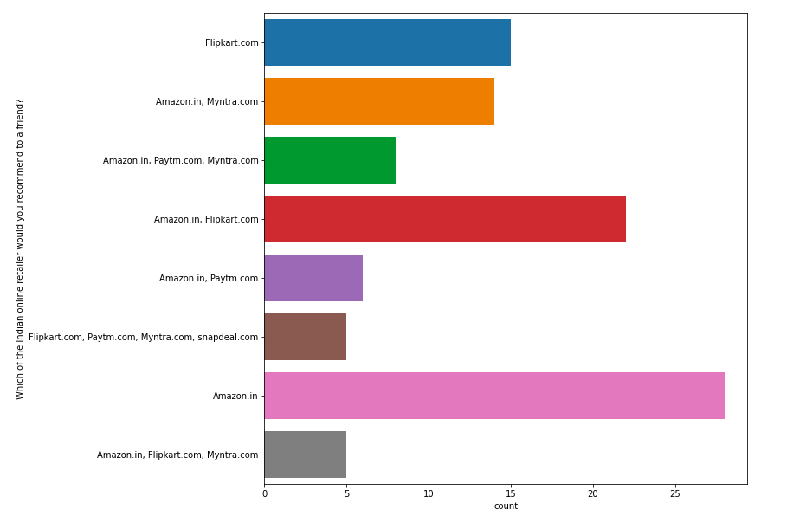
Which of the Indian online retailer would you recommend to a friend?
Amazon.in is the most recommended website, among all other website.
Myntra.com & Flipkart.com, are on the 2nd in recommendation

Slide 23
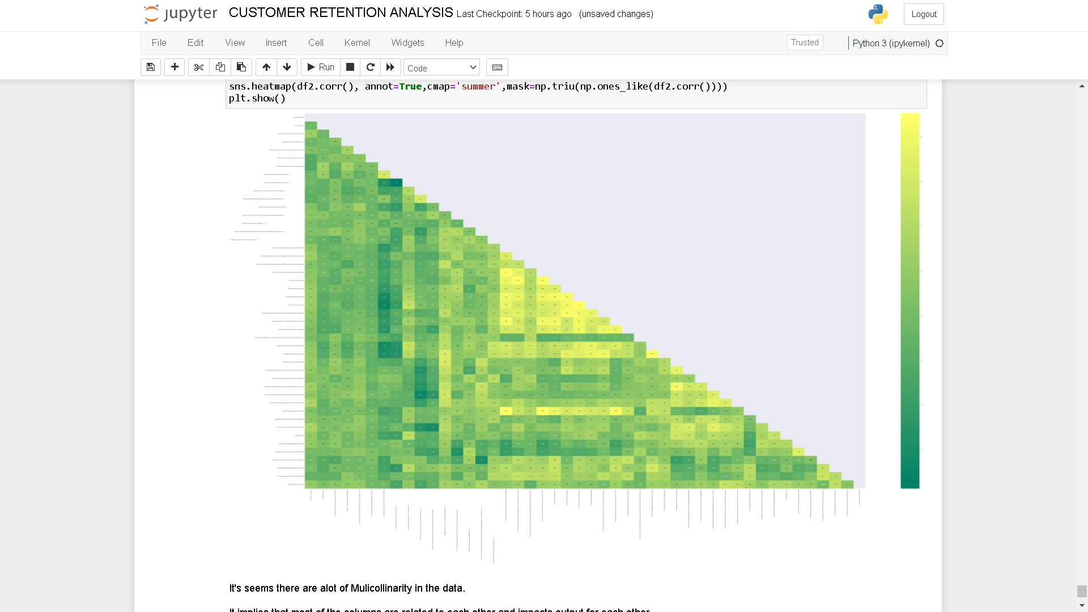
Multicollinearity
There are multicollinearity problem present in our dataset. Most of the columns are correlated with each other.
It implies that most of the columns are related to each other and impacts output for each other.

Slide 24
Normal Distribution & Outliers.
Almost all the columns are categorical columns as they are encoded ones. So we will be getting these kind of plots.
Since all the columns are Categorical features therefore no outliers in the data

